Slide 1
LINEAR REGRESSION
Artificial Intelligence And Machine Learning
COST FUNCTION
Gives us a measure of the error in the prediction
This error allows us to interpret how good the model is performing
We can use this to find optimal values for our parameters that reduce the cost i.e., give less error
Cost function is generally represented by ‘J’
Some examples of cost functions are:
1. Mean Squared Error (MSE)
2. Mean Absolute Error (MAE)

Slide 2
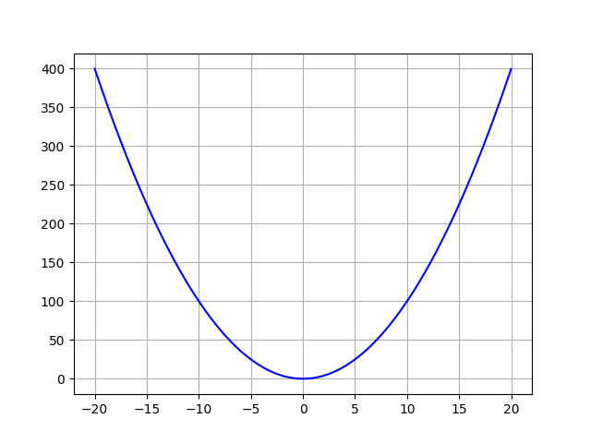

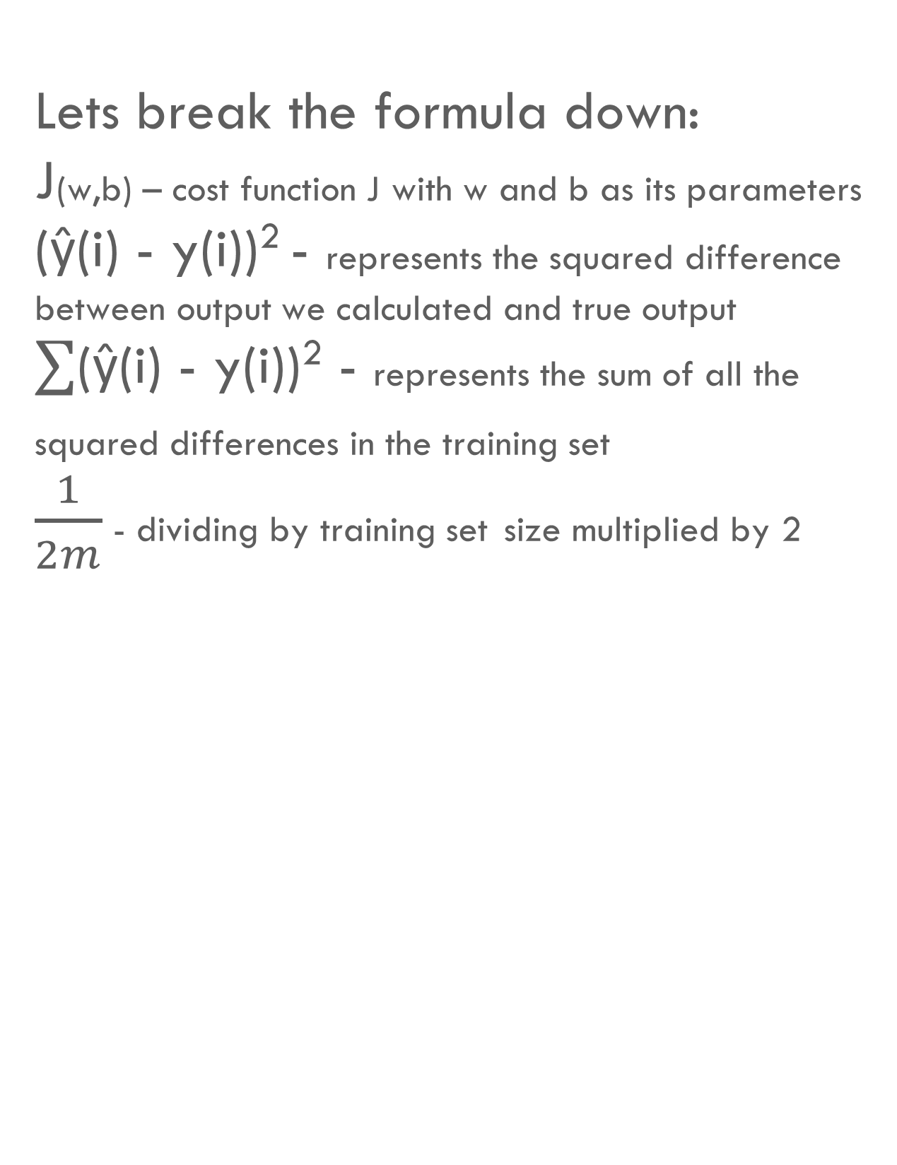
LINEAR REGRESSION
Artificial Intelligence And Machine Learning
MEAN SQUARED ERROR (MSE)
Graph of y = x ²
The function for mean squared error is:
J(w,b) = $\frac{1}{2m}∑$(ŷ(i) - y(i))²
Lets break the formula down:
J(w,b) – cost function J with w and b as its parameters
(ŷ(i) - y(i))² - represents the squared difference between output we calculated and true output
$∑$(ŷ(i) - y(i))² - represents the sum of all the squared differences in the training set
$\frac{1}{2m}$ - dividing by training set size multiplied by 2
(-15,225)
Cost J(w,b) where b = 0
(10,100)
(0,0)
w

Slide 3
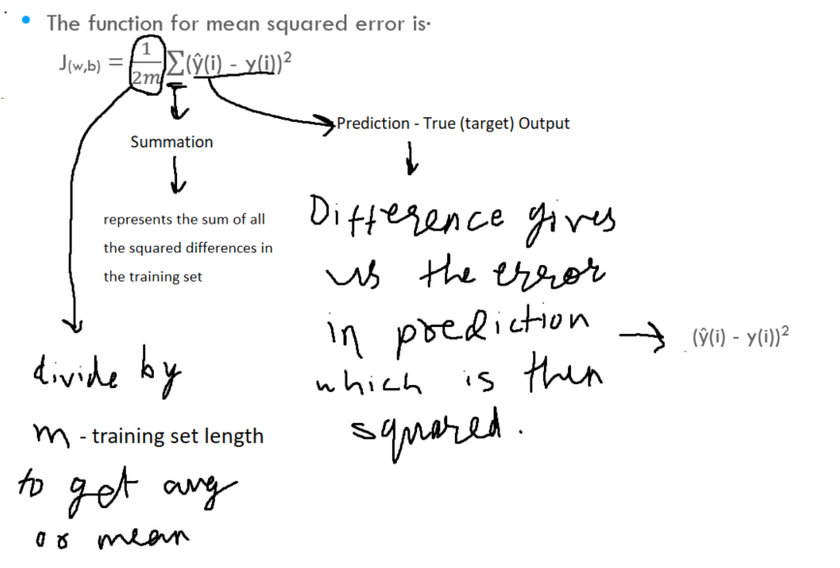

Slide 4
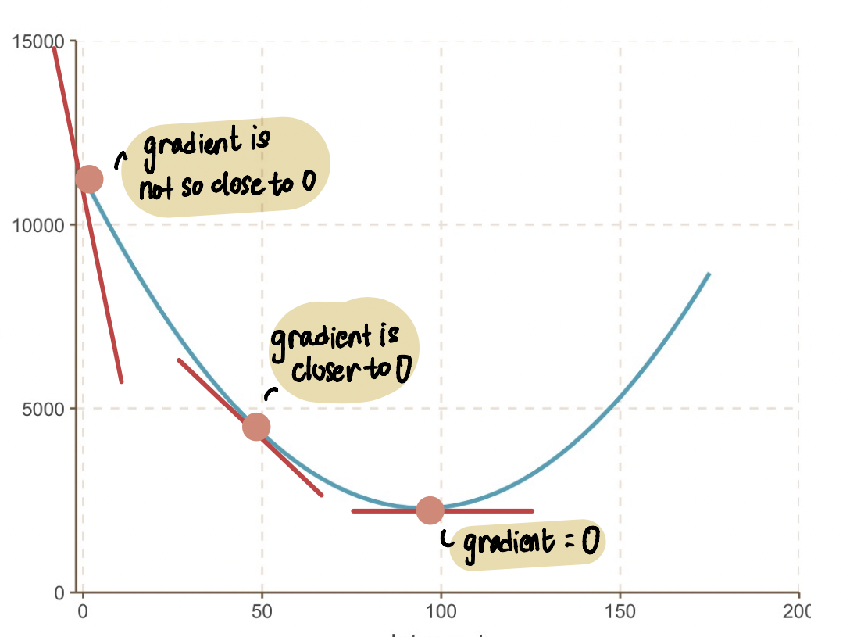
LINEAR REGRESSION
Artificial Intelligence And Machine Learning
GRADIENT DESCENT ALGORITHM
Gradient descent is a learning algorithm that updates the values for our parameters over iterations to arrive at optimal values for accurate predictions.
The algorithm does this by reducing the cost
or error every iteration
This is done by finding the partial derivative
of the cost function with respect to our
parameters, being weight and bias
J(w)
w

Slide 5
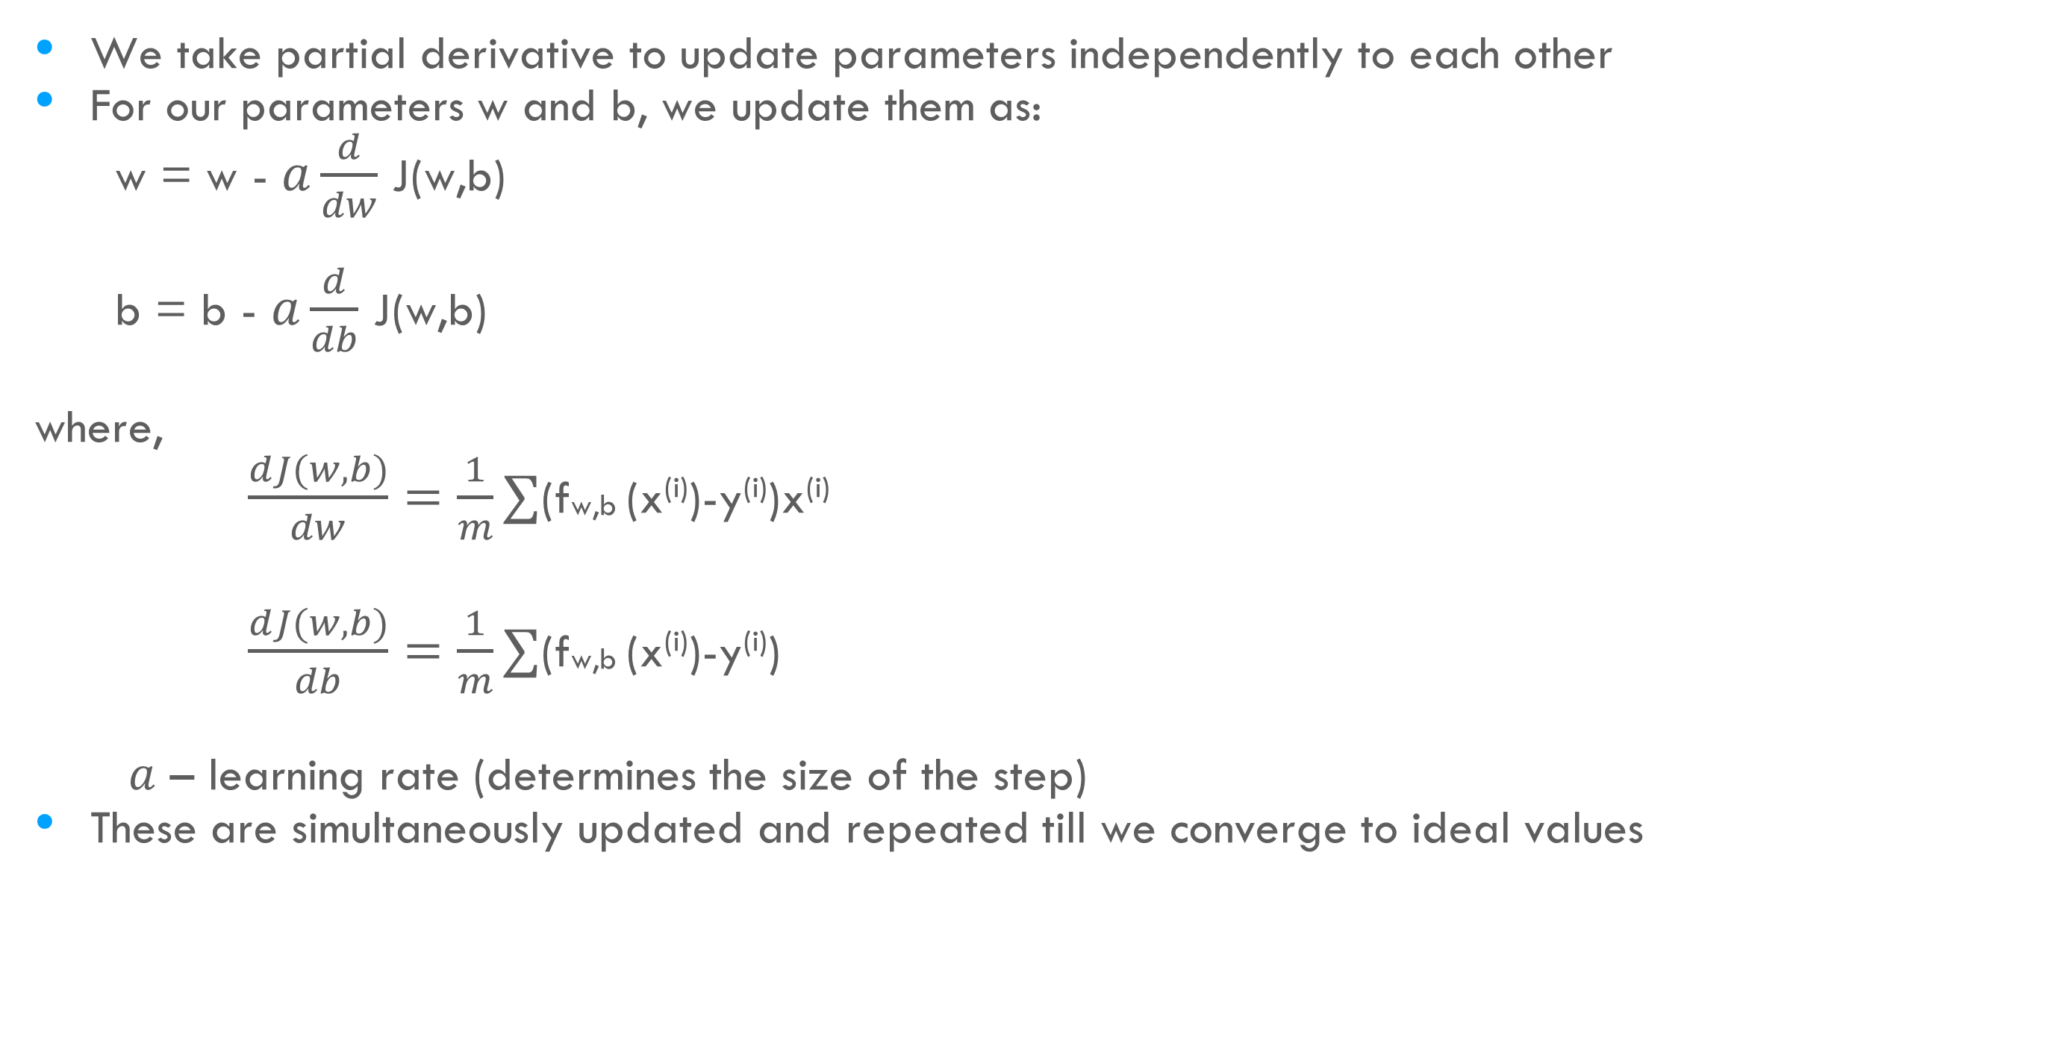
LINEAR REGRESSION
Artificial Intelligence And Machine Learning
GRADIENT DESCENT ALGORITHM
We take partial derivative to update parameters independently to each other
For our parameters w and b, we update them as:
w = w - $a\frac{d}{dw}$ J(w,b)
b = b - $a\frac{d}{db}$ J(w,b)
where,
$\frac{dJ(w,b)}{dw}=\frac{1}{m}∑$(fw,b (x^{(i)})-y^{(i)})x^{(i)}
$\frac{dJ(w,b)}{db}=\frac{1}{m}∑$(fw,b (x^{(i)})-y^{(i)})
$a$ – learning rate (determines the size of the step)
These are simultaneously updated and repeated till we converge to ideal values
m-1
i = 0
m-1
i = 0

Slide 6
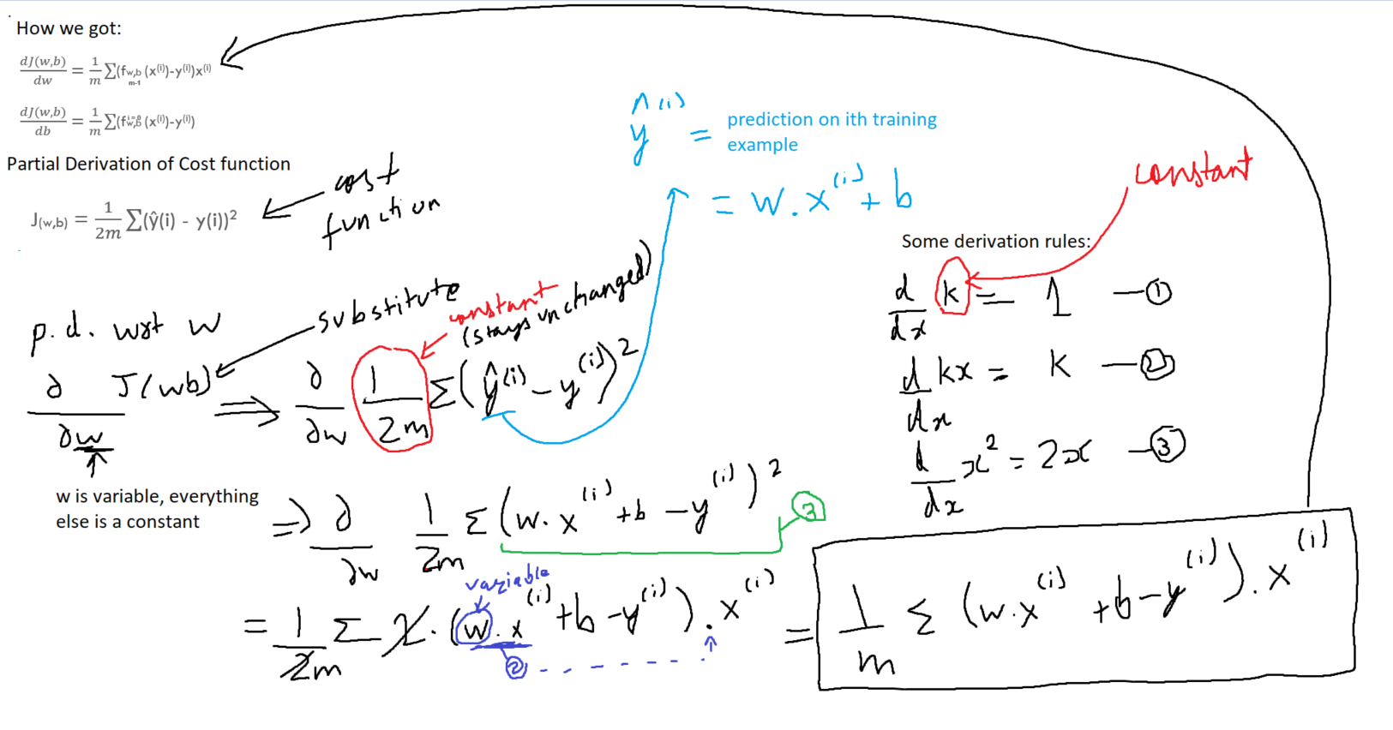
For w:

Slide 7
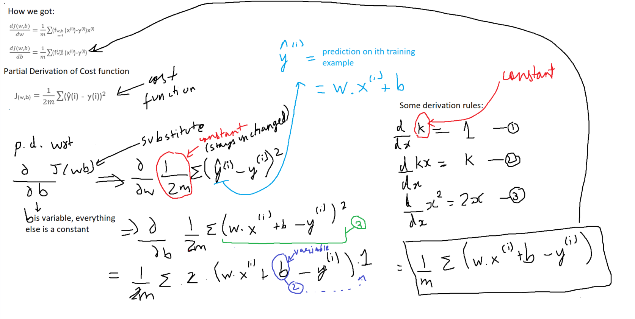
For b:

Slide 8
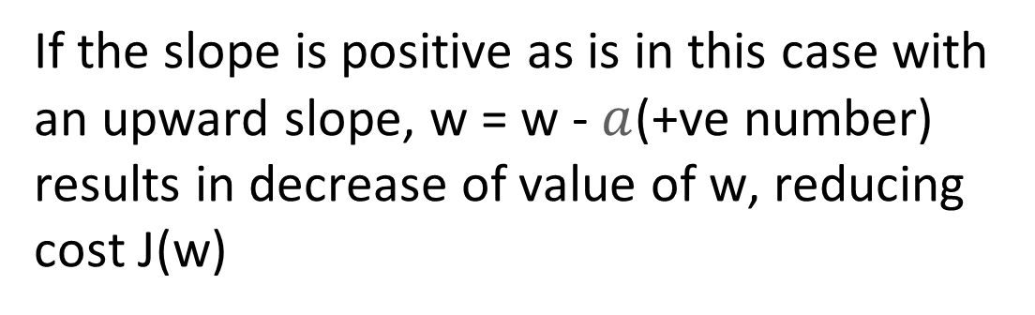
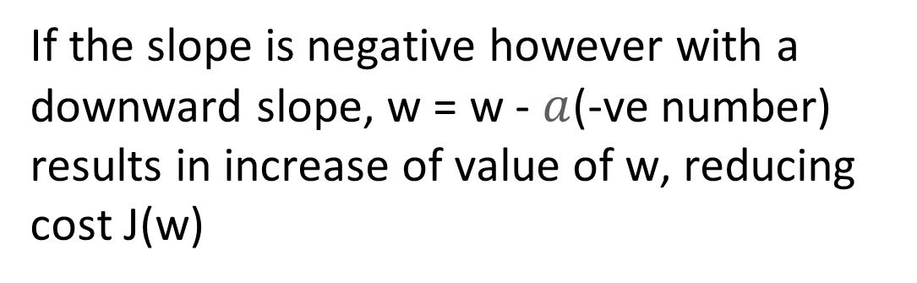
LINEAR REGRESSION
Artificial Intelligence And Machine Learning
WHY DERIVATIVE?
At a point p, the slope of the line is the derivative of J(w) function
J(w)
p
If the slope is positive as is in this case with an upward slope, w = w - $a$(+ve number) results in decrease of value of w, reducing cost J(w)
w
J(w)
If the slope is negative however with a downward slope, w = w - $a$(-ve number) results in increase of value of w, reducing cost J(w)
p
w

Slide 9
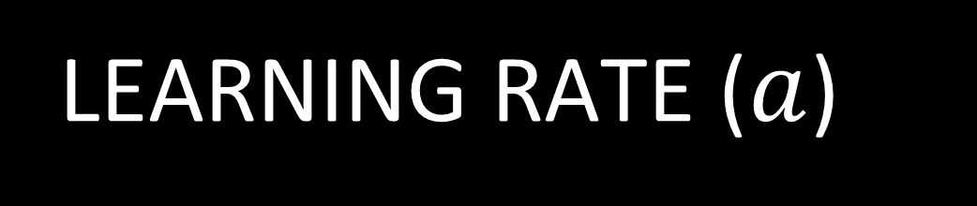
LINEAR REGRESSION
Artificial Intelligence And Machine Learning
LEARNING RATE ($a$)
J(w)
J(w)
p
p
w
w
If the learning rate is too small, gradient descent will always converge to the optimal value, however, it will take a lot more steps than required to reach these values. This is inoptimal as it uses a lot more resources and time
If the learning rate is too large, it can lead to overshooting the minimum, making it possible to never reach optimal values. Instead of converging, we might diverge

Slide 10
